Slide 1
Dino Run and Galaxy Dash
Team: Honeydew
Notes:
diana

Slide 2
Team Structure: Names and Roles
Director - Noah
Producer - Diana
Art Lead - Octavio
Design Lead - Nick
Sound Lead - Tom
Tech Lead - Josh
Notes:
diana

Slide 3
High Concept
Dino Run is a simplistic infinite runner set in a desert setting, the player or the dinosaur, is trying to run for as long as possible without running to any of the obstacles, which includes various different cacti and pterodactyl. The farther the player runs, the higher their score, so the overall objective is to beat your high score by getting as far as possible in the level.
Notes:
noah

Slide 4
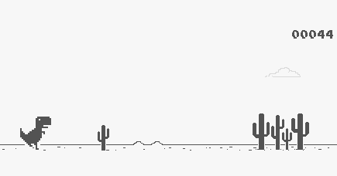
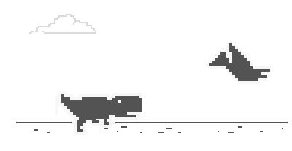

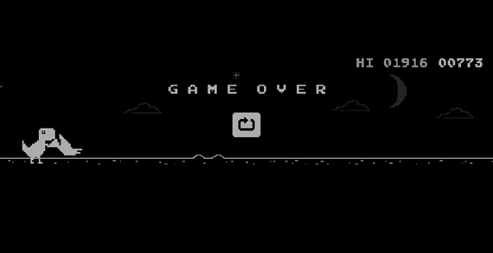
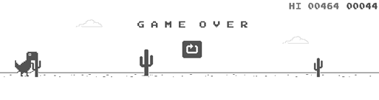
Reference
Notes:
diana

Slide 5
Design And Features
Keyboard for input
You control a dinosaur
Up and down movement with spacebar and/or arrow keys
Cacti and Pterodactyls used as obstacles
Notes:
Josh

Slide 6

Engine And Features
Unity
Game development engine
Basic Physics, Colliders, Animation tools, etc.
Uses Visual Studio
Notes:
Josh

Slide 7
Art - Master Copy
Style - Pixel art
Using Piskel
Shapes
Pixelated, simple, easy to understand
Colors
Black and white, no other additional colors
Sizes
Each sprite will be 102 by 104 pixels
Notes:
Octavio

Slide 8
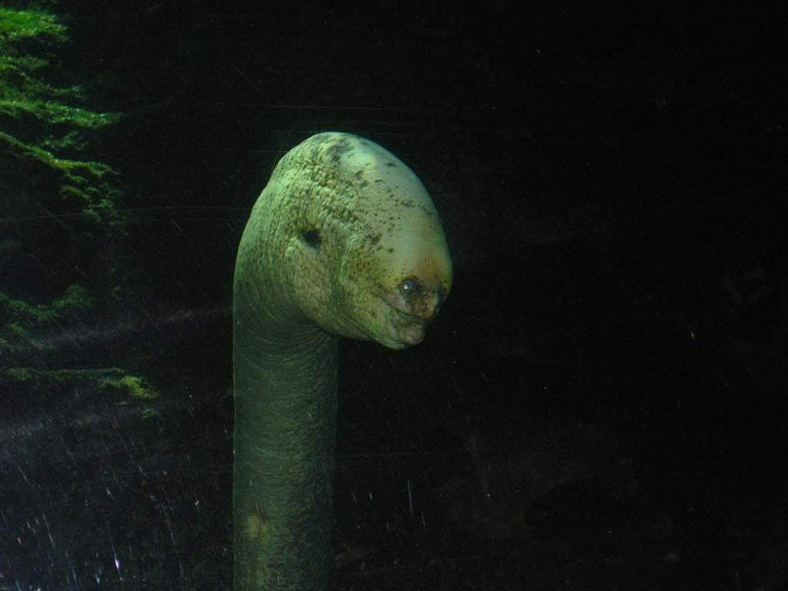
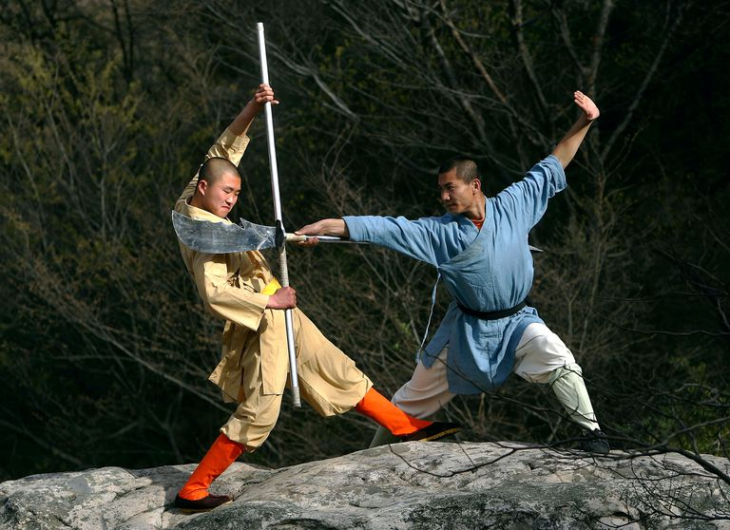
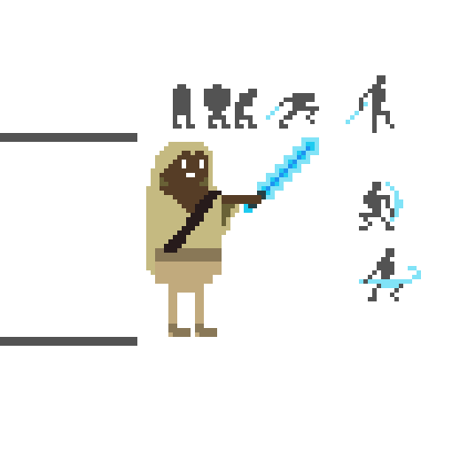
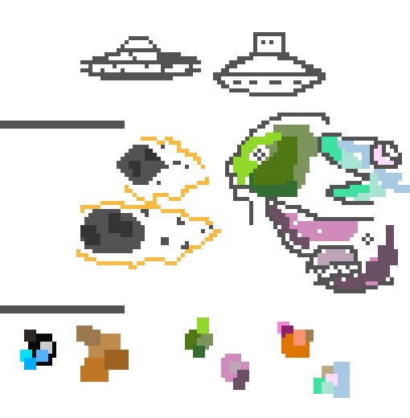
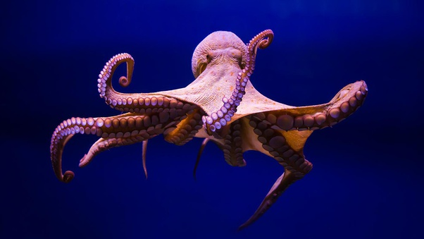
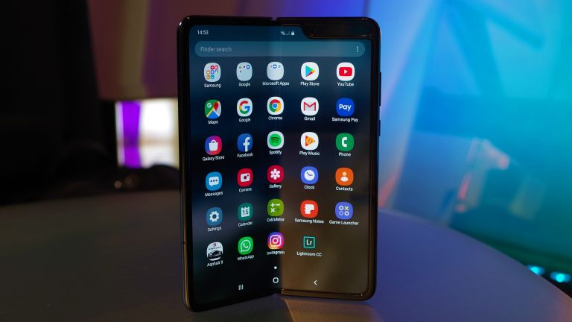

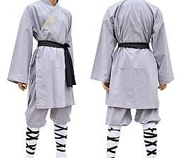
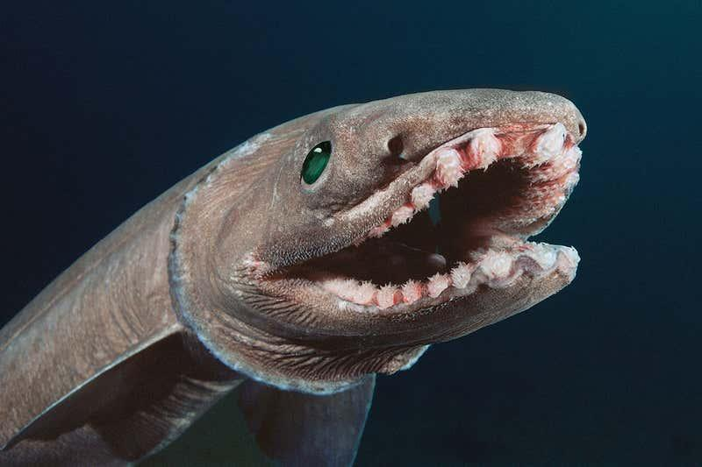
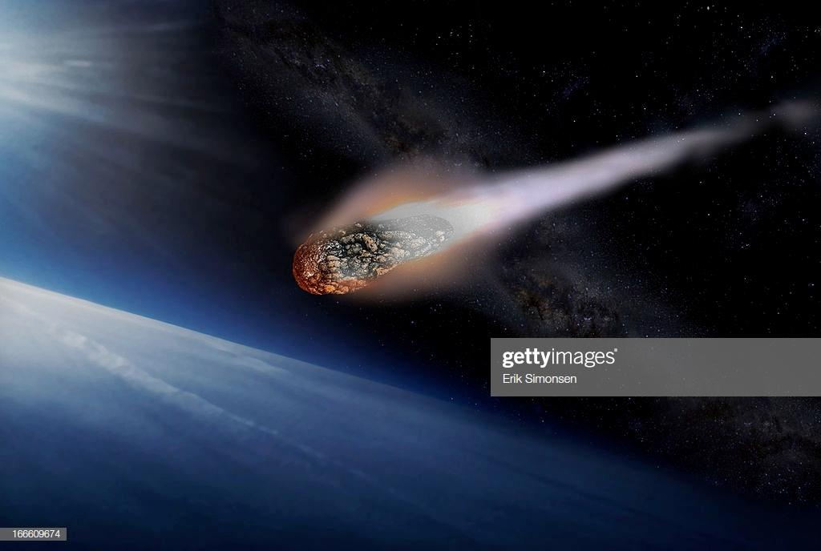

Art Asset Research Plus Content
Notes:
Octavio

Slide 9
Audio - Music and Sound
Master Copy
Total of 4 sound effects
1 day of work
Plus Content:
Background music
2 days of work
More sound effects
1 day of work
Notes:
Tommy
Totoal of 4 sounds in the Master Copy will take 1 day
Plus Content has a Main Theme will take 1 to 2 days
Plus Content also has Different Sound effects will take about 1 day

Slide 10
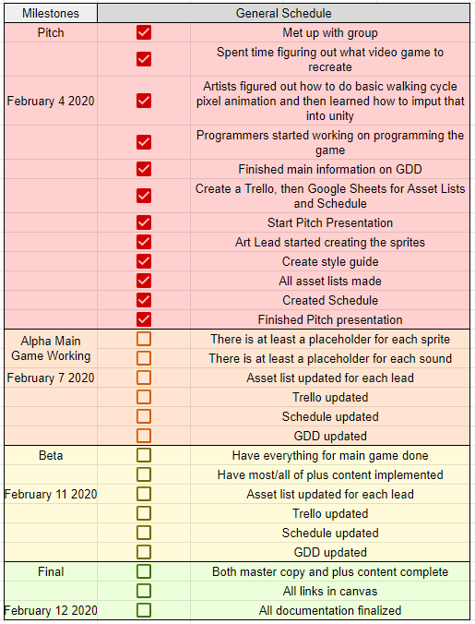
Main Schedule
Notes:
Diana

Slide 11
Plus Content
Plus Art
Space themed additions
New figure for dinosaur
Aliens instead of cacti
U.F.Os instead of pterodactyls
Adding meteorites as well
Plus Sound
Background music
More sound effects
Plus Programming
Adding jump attack to player
Notes:
Noah

Slide 12
Risk 1 - Overworking or Not Working Enough
What Does This Mean:
Doing too much work will be hard to fully document, or the work will not be what is supposed to be done until later when other things are supposed to be finished by other team members
If someone doesn't know what to do and does not ask for a task, that can heavily hinder the progress of the entire project
Solutions:
When starting a new task, tell the producer/game director and make sure they document it
Ask the game director/producer what to do if you are unsure what to work on
Notes:
Nick
Doing too much work will be hard to document and take time out of other tasks
Not knowing what to do and not asking for a task will be a major setback
Tell the producer/game director to document your new task
Ask the producer/game director when you are not on a task

Slide 13
Risk 2 - Missing People
What Does This Mean:
When people are absent, especially without notice, that can heavily stunt the progress of the project
Mitigations:
No Sound Lead - Other sound specialized team member subs
No Tech Lead - (in this case) Director subs (since he is the other programmer of the team)
No Game Designer - Programmer or Tech Lead subs
No Game Director - Producer subs
No Producer - Director subs, with the help of other leads
No Art Lead - Artist subs
Notes:
Tommy
If I the Sound Lead am not here then Nick subs for me
If the Game Director Noah isn’t here then Diana Subs for Noah
If the Producer Diana isn’t here then Noah subs for Diana
If the Art Lead Octavio isn’t here then Diana subs for Octavio
If the Tech Lead Josh isn’t here then Noah subs for Josh
If the Game Director Nick isn’t here then Josh subs for Nick

Slide 14
Risk 3 - Way Too Much Plus Content
What Does It Mean:
We may try to do too much plus content, which in the end will be too difficult to complete in the time we have, and it could also make it too hard to understand what the original game was
Mitigations
Limit plus content or do at least the most important parts first, adding more things if there is time
Notes:
Nick
Doing too much plus content will take more time and make it hard to understand the original game
Do the most important parts first, then add more content if there is time

Slide 15
Budget and Materials
DigiPen computers
Keyboard and mouse
Software: Unity
Sites: Piskel, Google Sheets, Trello, Github, DigiPen Canvas and Email
Research Items: Internet
Phone (for connecting with other teammates)
Notes:
Noah

